Slide 2


Greater Akron LGBTQ+ Community Needs Assessment Project Proposal
Andrew M. Snyder www.amsnyder.com

Slide 3
The Value of Community Needs Assessments (CNA)
“Community Needs Assessments (CNA) synthesize and disseminate valuable information to support and validate decision making and commitments to implementing community health interventions, resources and investments.
Capturing insight about the current health status and potential accomplishments/deficiencies in community services and community resources that would inform key stakeholders (with-in and outside of the healthcare sector) committed to delivering culturally competent services contributing to overall improved health status of the target population.”

Slide 4
Vision for Greater Akron LGBTQ+ CNA
Project coordinated by Andrew Snyder, PI
Conducted in full collaboration with community
    Full list of key community partnerships to be identified and secured
      Likely to be a large number (50+)
Research driven framework & values
  Apply community based participatory research (CBPR) principles
  Holistic view of health and wellness in the community (8 domains)
  Intentionally inclusive approach
  Findings are disseminated in a way that all people can understand, access and utilize
Sustainability
  Creating a plan to keep the initiative alive and ongoing

Slide 5

Overarching Goals
Increase awareness about public health as it relates to the LGBTQ+ community in Greater Akron
Describe the local LGBTQ+ population demographically
  Currently unassessed, relying on estimates
Describe current status and resources available to the local LGBTQ+ community by domain
  Identify the strengths and achievements
  Identify weaknesses and unmet needs
Develop recommendations that inform future investments and decision-making for the local LGBTQ+ community
Strengthen partnerships within the local public health system

Slide 6
What Makes Our Community Needs Assessment Special

Slide 7
Community Based Participatory Research Principles Applied to Community Needs Assessment
CBPR Principle | Community Needs Assessment Application
Community as unit of identity | “Community” of focus is defined in conversation with community members, not by hospital service are or stereotypical demographic categorization
Emphasis on strengths and resources | Deficit-based, top-down approach is replaced with an emphasis on community assets and what is already working
Collaborative involvement | Diverse community members are involved in every phase of the CNA process from design to evaluation
Mutual benefit | Process is designed to benefit all stakeholders, not just help hospital meet their regulatory requirements
Empowering processes | Process focusses on shared power and equity in the process, relinquishing control from the hospital to as many stakeholders as possible
Cyclical, iterative process | Static, linear process is replaced with an on-going cycle of data collection, analysis, planning and evaluation
Positive and ecological perspectives | Overemphasis on deficits and individualized health outcomes is replaced with a contextual focus that assume potential for progress
Shared knowledge | Findings are disseminated in a way that all people can understand, access and utilize
Long-term commitment | While CNAs are more than a three-year process, hospitals choose a long-term investment beyond the reporting period or the tax year

Slide 8



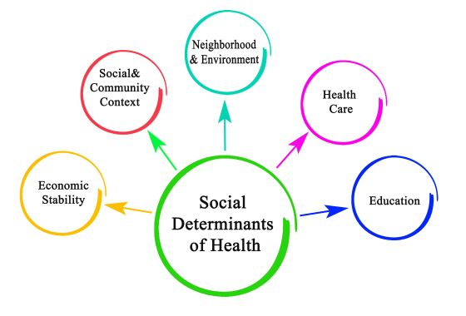





Holistic Approach:
8 Domains of Health
Health & Wellness
Religion & Spirituality
Education & Literacy
Housing, Food and Nutrition
Business & Commerce
Safety & Law Enforcement
Recreation & Leisure
COVID-19 Considerations

Slide 9
Intentional Inclusivity
LGBTQ+ specific CNA’s methodologies which overlook the importance of intentionally capturing inclusive data yield misrepresentation in the actual health status of marginalized populations
  Disproportional distribution of resources (specifically for cis-gender women, people of color, transgender and low-income communities to name a few)
    Ensure diverse representation in every phase of the project
Published literature documents a history of gentrification in gay districts and ‘gayborhoods’, as well as a painful history of exclusion and discrimination resulting in the diffusion of specific LGBTQ+ sub-groups from built gay communities
  Identify and engage community members outside of the ‘gayborhood’ both geographically and socially to participate in every phase of the project
Geographically binding CNA’s to known gay districts and non-inclusive gay community structures leads to the exclusion of marginalized LGBTQ+ individuals from engaging in the CNA data collection process.
  Strive to expanding data collection outside of metronormative gay spaces dominated by white, cisgender men, who populate “gayborhoods”, to inclusive queer spaces that encompass diverse members of the LGBTQ+ community who may be underrepresented in traditional CNAs (i.e., transgender and gender expansive communities, people of color, cis-gendered women, low income and rural populations to name a few)

Slide 10
Detailed Methodology

Slide 11
Organizational Structure
Steering Committee
Andrew Snyder
(Will be replaced with a working board after initial report)
Diversity Committee
Support
Volunteers
Health & Wellness
Religion & Spirituality
Education & Literacy
Housing, Food & Nutrition
Business & Commerce
Safety & Law Enforcement
Recreation & Leisure
COVID-19 considerations
Domain Leadership Team
Domain Leadership Team
Domain Leadership Team
Domain Leadership Team
Domain Leadership Team
Domain Leadership Team
Domain Leadership Team
Domain Leadership Team
Key Community Partnership Working Group
Key Community Partnership Working Group
Key Community Partnership Working Group
Key Community Partnership Working Group
Key Community Partnership Working Group
Key Community Partnership Working Group
Key Community Partnership Working Group
Key Community Partnership Working Group

Slide 12
Organizational Representation by Domain
Health & Wellness
  Akron AIDS Collaborative
  Cleveland Clinic Akron General
  CANAPI
  Summit County Health Department
  Medina County Health Department
  Akron Community Foundation & Gay Community Endowment Fund
  Battered Women’s Shelter & Rape Crisis Center
  OutSupport Medina
  Summa Health & LGBTQ+ Clinic
  Summit County Court Appointed Special Advocates
  Medical Mutual
  Kent State University, College of Public Health
  Margie's Hope
  CASA
  Equitas Health
  Portage Path Behavioral Health Center
  Planned Parenthood
  Mental Health and Recovery Board of Portage County
  Akron Children's Hospital & Gender Affirming Clinic
Religion & Spirituality
  Battered Women’s Shelter & Rape Crisis Center
  CANAPI
  Ursuline Sisters HIV Ministry
  United Church of Christ – Canton
  The SSOULE Group
  United Church of Christ Congregational
  First Universal Church of Westfield Center
  Kut From a Different Cloth Support Group
  Emmanuel Fellowship Church
Education & Literacy
  University of Akron
  Kent State University
  Gay, Lesbian, and Straight Education Network
  CANAPI
  Akron Public Schools
  Stark State College
  United Way – Summit & Medina
  Medical Mutual
  Ohio Psychological Association
  Planned Parenthood
Recreation & Leisure
  CANAPI
  Akron Pride
  Akron and Summit County Convention and Visitors Bureau
  The SSOULE Group
  Superscript Comics and Games
  PFLAG – Akron
  Conservancy for Cuyahoga Valley National Park
  National Parks System
  Krown Bay Productions
Housing, Food, & Nutrition
  PFLAG - Kent
  CANAPI
  Akron Canton Regional Food Bank
  Summit County Continuum of Care
  Direction Home Akron Canton
  Center for Community Solutions – Cleveland
  United Way – Summit and Medina
Business & Commerce
  Goodyear Employee Pride Group
  OutSupport Medina
  Battered Women’s Shelter & Rape Crisis Center
  Akron Chamber of Commerce
  Main Street Medina
  Strung by Shawna
  Planned Parenthood
Safety & Law Enforcement
  City of Akron, Criminal Division
  Kent State University Police Department
  CANAPI
  Battered Women’s Shelter & Rape Crisis Center
  Akron Police Department
  Akron Fire Department
  Summit County Juvenile Court
  Akron Municipal Court
  NAACP
  Town Hall II
Notes:
Organizations listed in yellow have been approached and are interested in participating but are pending formal commitment

Slide 13
Additional Community Partners & Supporters
Ohio Guidestone
Kent Interfaith Alliance
Buckeye Flame
Akron Canton Regional Foodbank
Faith in Action
CHC Addiction Services
Gardiner
Small Organization Solutions
Cleveland Foundation
Oriana House
Kent Wired
WKSU
TRIAD
James A Garfield Local School District
GAR Foundation
The Portager
Family and Community Services – Portage County
Domestic Violence Project, Inc.
Kent City Health Department
Akron AIDS Collaborative
Akron Soul Train
Accelerant
Leadership Akron
Arts Now
Hospice of Western Reserve
Goodwill of Greater Cleveland
Equality Ohio
City of Akron Chamber of Commerce
Weathervane Theater
PLEXUS – LGBTQ+ Chamber of Commerce
NEOMED
Notes:
Organizations listed in yellow have been approached and are interested in participating but are pending formal commitment

Slide 14
Methodology (Mixed-Method)
Breaking the mold on top-down, traditional data collection approach – Year 1
  Data collection initiated by domain leadership teams with guidance from project coordinator
    Secondary Data Collection
      Systematic identification and collection of existing information and datasets
    Primary Data Collection
      Super Survey - incentivized, digital, intuitive ‘super survey’ utilizing snowball methods launched at 2021 Akron Pride Festival and identified venues of significance to the community
      Hosting focus groups – both to inform super survey questions and to capture qualitative data
      Stakeholder interviews
      Community activities
  IRB approval will be secured for all data collected
Analysis and Evaluation – Year 2
  Analysis of data collected from each domain of health will be compiled for dissemination in the final community report
  Project will be evaluated upon completion of first final community report
Notes:
n=379 (95% confidence, 5% margin of error, assuming population size of 24,346)
Total Summit Co. Population – 541,013
Estimated Total LGBTQ+ Population (4.5% Gallop, 2017) – 24,346
20% response rate need to invite 1895 individuals to complete the survey

Slide 15
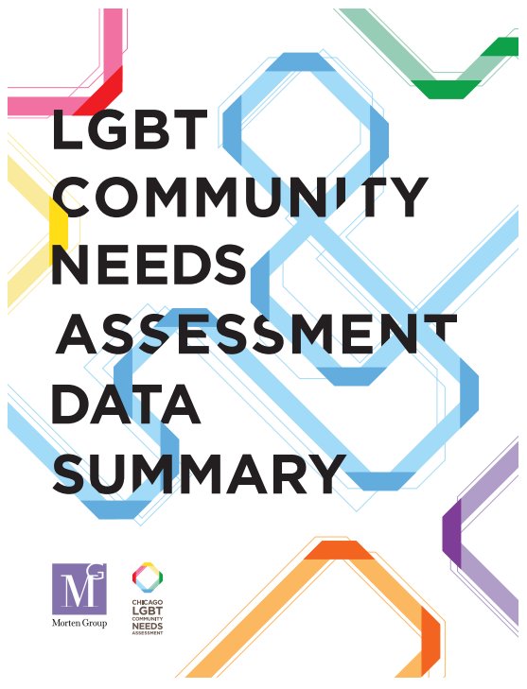

Dissemination
Primary Produce - Final Community Report
  Create a branded look for the initiative including a logo mark
  Final Needs Assessment Document
    Organized, digestible, easy to use document
    Available in print and digital versions
  Social media graphics
    Up to 10 social media graphics to raise awareness of most important community facts and figures
  Needs Assessment Website
    Branded site will continue the look and feel of the document
    Feature key facts and figures
    Option to e-mail for more information
    Option to download the full needs assessment
    Will include custom domain name
    Includes sponsorship acknowledgements
Notes:
https://cct.org/wp-content/uploads/2015/05/LGBTCommunityNeedsAssessment.pdf

Slide 16


Project Timeline
Phase 1: Planning Phase 2: Data Collection Phase 3: Analysis & Evaluation Phase 4:Dissemination
Jan, 2021 Feb, 2021 Aug, 2021 Jan, 2022 July, 2022 August 2022
Strategic Planning Process (In Progress)
Mobilize Sponsorship From Community Stakeholders (In Progress)
Secure Funding For Full Project Proposal (In Progress)
By January 2021
Secondary Data Collection: Existing Data Collection and
Host Focus Groups
February – December 2021
Primary Data Collection: Initiate ‘Super Survey’ at 2021 Akron Pride and Venues of Significance
August - December 2021
Data Analysis and Project Evaluation
January 2022 – July 2022
Present Final Report to the Community – Celebrate at Akron Pride 2022
By August 2022

Slide 17
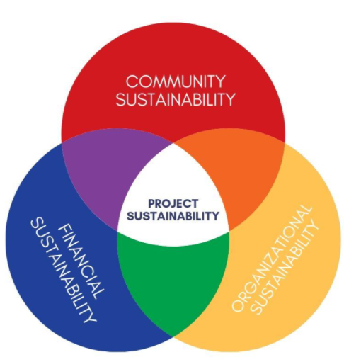
Sustainability
Organizational Sustainability
  Adopt clearly articulated roles and responsibilities of all working members of the group including formal process for joining and dissolving from the group
  Identify and Install a working Board of Trustees from Domain Leadership Teams to oversee project success past August 2022
Community Sustainability (Key Community Partnership Working Groups)
  Ensure the values of intentional inclusion reflect in future needs assessment activities
  Ensure that community-based participatory research principles are applied to future needs assessment activities
  Ensure continued focus on holistic health
Financial Sustainability
  Identify appropriate long-term local LGBTQ+ organization to assume
  financial responsibility
    Develop the funding to continue the assessment cycle

Slide 18
From Assessment to Action
Macro Action-Planning
  Encourage Needs-Based Action Planning
    Review the information that is now available
      Carefully take a second look at potential solution strategies
        Think about how stakeholders and the community can implement the solutions
      Examine the structure of the community
        Consider the ability of the community to handle disruptions and changes caused by solution strategies
    Key stakeholder success mapping
    Other important activities as needed
Micro Action-Planning
  Present assessment finding in an accessible, easily digestible, report for individual community stakeholders to implement recommendations that address worrisome findings

Slide 19
Sponsorship: A Giving Level for Everyone
  Visionaries - $20,000 and Up
Never underestimate the heart of a champion
Includes named ‘special’ acknowledgement and large photo/logo in final report document (digital and print) and on website
Custom printed copy of final report
Acknowledgement in press release
Those that want to help support the community to mobilize long-term objectives aimed at a sustainable, self-determining community
Includes named acknowledgement and photo/logo in final draft document and on website
Custom printed copy of final report
Community members and small businesses who want to advocate the needs of the local LGBTQ+ community
Includes named acknowledgement in final draft document and on website
Grassroots community members who want to support collective action for change at a local level
Includes named acknowledgement in final draft document
  $10,000-$19,999
Champions
  $5,000-$9,999
Mobilizers
  $1,000 - $4,999
Advocates
  Up to $999
Grassroots
Notes:
https://secure2.convio.net/ksu/site/SPageServer;jsessionid=00000000.app260a?pagename=give&form_id=4621&designee=4570&catId=1382#/

Slide 20

Funding Update – March 11th, 2022
Organization Name | Committed or Received
Cleveland Clinic Akron General | $10,000
Summa Health | $10,000
Summit County | $25,000
Summit County Public Health | $10,000
Kent State CPH | $20,000
Akron Children’s Hospital | $1,000
Akron Pride | $5,000
Gay Community Endowment Fund (ACF) | $10,000
City of Akron | $10,000
Read Family Fund | $5,000
Ann Brennan/Brennan Family | $25,000
Planned Parenthood | $3,000
ACF Impact Grant | $10,000
TRIAD | $7,500
Akron Art Museum | 801.09
TOTAL SUPPORT | $155,301
100%
Online giving portal remains open
90%
80%
70%
60%
50%
40%
30%
20%
10%
0%

Slide 21
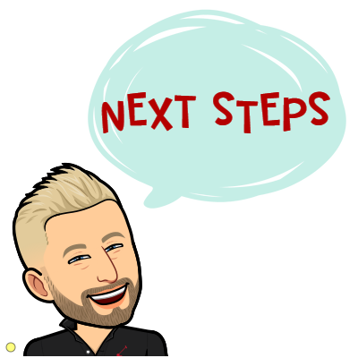
Next Steps

Slide 22

References
Horizons Foundation (2018). San Francisco Bay Area LGBTQ Community Needs Assessment. San Francisco, CA. Retrieved from https://horizonsfoundation.org
Kirk CM, Johnson-Hakim S, Anglin A, Connelly C. Putting the Community back into Community Health Needs Assessments: Maximizing Partnerships Via Community-Based Participatory Research. Prog Community Health Partnership. 2017;11(2):167-173. doi:10.1353/cpr.2017.0021. PMID: 28736409.
The Chicago Community Trust (2012). LGBTQ Community Needs Assessment Data Summary [PDF].Chicago, IL. Retrieved from https://cct.org/wp- content/uploads/2015/05/LGBTCommunityNeedsAssessment.pdf
Witkin, B. R. (1995). Planning and conducting needs assessments: A practical guide (1st ed.). Sage Publications.

Slide 23


www.kent.edu/publichealth

